Slide 1
Kaseya VSA Ransomware Attack (2021)
Devin Kandola
Markus Afonso Group: 41

Slide 2
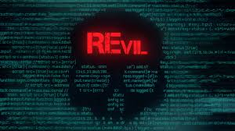
Overview of Kaseya VSA Ransomware Attack
Date: July 2, 2021
managed service providers (MSPs)
Main Target: Kaseya's Virtual System Administrator software
Notes:
On July 2, 2021, a cyber attack took place that made waves in the world of cybersecurity. This attack targeted a large group of managed service providers and their customers. It was a carefully planned attack carried out by a Russian-based cybercrime group named REvil, They're known for their ransom attacks. And this attack i particular affected over 1,000 organizations globally. And At the center of the attack was Kaseya's Virtual System Administrator software. This software is crucial for managed service providers as it helps them manage and monitor their clients' IT systems remotely.

Slide 3

The Goal of the Attacker
Financial motives
Ransom payments
Notes:
The main goal of the attackers in the Kaseya VSA ransomware attack was to make money by extorting organizations. They used advanced encryption methods to lock up the data of these organizations, demanding huge sums of money in exchange for the keys to unlock it. This shows how ruthless the attackers were in seeking illegal profits, highlighting the dangerous mix of cybercrime and financial exploitation in today's digital world.

Slide 4
Disruption of business operations
Disruption of business operations
Data loss or compromise
Financial losses due to downtime and recovery efforts
Notes:
The consequences of the Kaseya VSA ransomware attack were severe and widespread. It caused significant disruptions for the targeted organizations and had broader impacts on cybersecurity in general. The attack led to prolonged periods of downtime, halting important business operations and causing chaos. Additionally, the attackers encrypted sensitive data, leading to various long-term problems such as penalties for regulatory violations, damage to reputation, and loss of trust from stakeholders. These consequences highlighted the serious impact of ransomware attacks on both individual organizations and the larger cybersecurity landscape.

Slide 5

Compromised Security Objectives
Integrity: Data encrypted and held for ransom
Availability: Systems rendered inaccessible or unusable
Confidentiality: data exposed to unauthorized individuals
Notes:
After the attack, the hackers managed to undermine three crucial security goals: keeping information confidential, making sure data is accurate and trustworthy, and ensuring that systems are always available when needed.
Firstly, they got hold of confidential data without permission, breaking the trust of the organizations and putting sensitive information at risk of being seen by bad actors.
Secondly, they encrypted data and systems, which made it hard for the organizations to trust that their information hadn't been tampered with or changed.
Lastly, the attack caused a lot of downtime, making it difficult for organizations to do their work and for stakeholders to access important services. This hindered productivity and made it hard for everyone involved to get things done.

Slide 6
Business Impact
High business impact due to widespread downtime
Moderate to high financial impact from recovery efforts
Potential ransom payments
Ruined reputation
Notes:
The Kaseya VSA (Virtual Systems Administrator) ransomware attack had a massive impact on businesses, causing a chain reaction of problems that spread throughout the affected organizations using VSA.
The prolonged downtime caused by the attack was especially damaging.
led to significant financial losses as businesses couldn't operate normally, and they had to spend more money trying to fix the problem.
Additionally, the attack ruined the reputation of these organizations, making stakeholders doubt their ability to handle cybersecurity issues in the future.
This created long-lasting worries about whether the businesses were prepared to deal with similar threats in the future.

Slide 7
Assets Compromised
Confidential information
Mission-critical applications
Support systems
Notes:
The attackers targeted a wide range of important assets within organizations, including vital data storage, IT systems, and crucial operational infrastructure.
They infiltrated these assets and used encryption to lock, causing major disruptions to normal business operations.
$70 Million ransom for the decryption key
The damage caused by the attack went beyond just losing data; it deeply affected how these organizations functioned and their ability to stay resilient in the face of such threats.

Slide 8
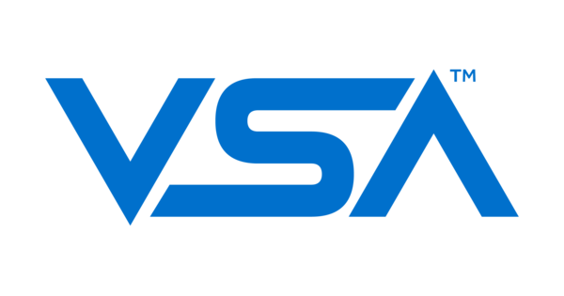
Attack Method
Exploitation of vulnerability in Kaseya VSA software
CVE 2021-30116
attacker installed a client for Windows from Kaseya
Downloads a file with Agent_Guid and AgentPassword
Can be used to log in and grabs a sessionId cookie
Access services not intended for use by agents
Notes:
The Kaseya VSA ransomware attack centered on exploiting hidden weaknesses in Kaseya's VSA software, which was a zero-day vulnerabilities.
By default, it offers a client download page at https://x.x.x.x/dl.asp.
When a client is downloaded and installed, it generates KaseyaD.ini file (C:\Program Files (x86)\Kaseya\XXXXXXXXXX\KaseyaD.ini) containing Agent_Guid and AgentPassword.
These can be used to log in on dl.asp, obtaining a sessionId cookie for subsequent attacks.
Login to any system, which is what the hackers used

Slide 9
How the Attack Could Have Been Prevented
Penetration testing
patching of software vulnerabilities
Implementation of backup measures
Access controls
IP blocking
Notes:
Penetration testing
Could’ve found the issue and prompted a patch to fix
having good backup plans in case something goes wrong.
Prevent anyone from downloading the client
IP blocking, which is what they used initially to block the attackers from accessing from their AWS launch point

Slide 10
Conclusion
Disruption to business systems
Financial losses
Could’ve been prevented
Lesson Learned
Notes:
In summary,
This attack caused wide spread downtime to business
All businesses using Kasya VSA had some sort of financial loss since
the attack highlighted the importance of finding exploits before hackers do
Hackers encrypted data across a portion of machines demanding money for the decryption key
organizations should learn from this so they can strengthen their defenses and prevent future attacks

